Slide 1


CARD MANAGEMENT SYSTEM
Integrated Banking System - Use Case - 5
Laima Singla
Pragya Goyal
Shubham Bhutada
Mohit Pursnani

Slide 2
REQUIREMENTS
Customer Level Operations
a. Apply for a credit or a debit card (of various types like platinum/gold etc.).
b. Reset PIN
c. Report loss of card.
d. Apply for card up-gradation
e. Request card statement for a specific period.
f. Report statement mismatch.
Bank Representative Level Operations
a. Approve or decline card request.
b. Activate or deactivate a card.
c. View card statement
d. View and reply for a statement mismatch ticket.
OUT SCOPE
1. Active loans of the customer at the time of issuing of new cards.
2. Calculating the credit score.
3. Recording third party gateway transaction.
4. Verification of details of and appropriate action mismatch statement in case of fraudulent activity.
ASSUMPTIONS
Users are existing customers of the bank.
The request status is kept pending before the approval/decline from bank representative side.

Slide 3
REVIEW – 09/10/2019
- Adding the BLOCK Function.
(The user shall fail to upgrade/reset the pin if the card has been blocked)
- Customer should be able to track the status of the query.
- Generating a new card(debit/credit).
- Limiting the day count for viewing statement.
- Multiple validations.

Slide 4

Customer Functionalities
CREDIT CARD
DEBIT CARD
LIST_EXISTING_CREDIT_CARDS
APPLY_NEW_CREDIT_CARD
UPGRADE_EXISTING_CREDIT_CARD
RESET_CREDIT_CARD_PIN
REPORT_CREDIT_CARD_LOST
REQUEST_CREDIT_CARD_STATEMENT
CREDITCARD_STATEMENT_MISMATCH
LIST_EXISTING_DEBIT_CARDS
APPLY_NEW_DEBIT_CARD
UPGRADE_EXISTING_DEBIT_CARD
RESET_DEBIT_CARD_PIN
REPORT_DEBIT_CARD_LOST
REQUEST_DEBIT_CARD_STATEMENT
DEBITCARD_STATEMENT_MISMATCH
CUSTOMER_LOG_OUT
VIEW_QUERY_STATUS

Slide 5
Admin Functionalities
LIST_QUERIES
REPLY_QUERIES
VIEW_DEBIT_CARD_STATEMENT
VIEW_CREDIT_CARD_STATEMENT
BANK_LOG_OUT
APPROVED
IN_PROCESS
DISAPPROVED

Slide 6

QUERY TABLE
Abbreviation | Description of the query
ANDC | Apply new debit card
ANCC | Apply new credit card
RDMT | Raise debit mismatch ticket
RCMT | Raise credit mismatch ticket
RDCU | Request debit card upgrade
RCCU | Request credit card upgrade
RDCL | Request debit card lost
RCCL | Request Credit card lost
CASE-ID-GENERATION
The CaseID generated has 16 digits.
Example: ‘ANDC19102212325302’
Stands for :
Apply New Debit Card_(22/10/2019)_(12:32:54)_(XX)

Slide 7
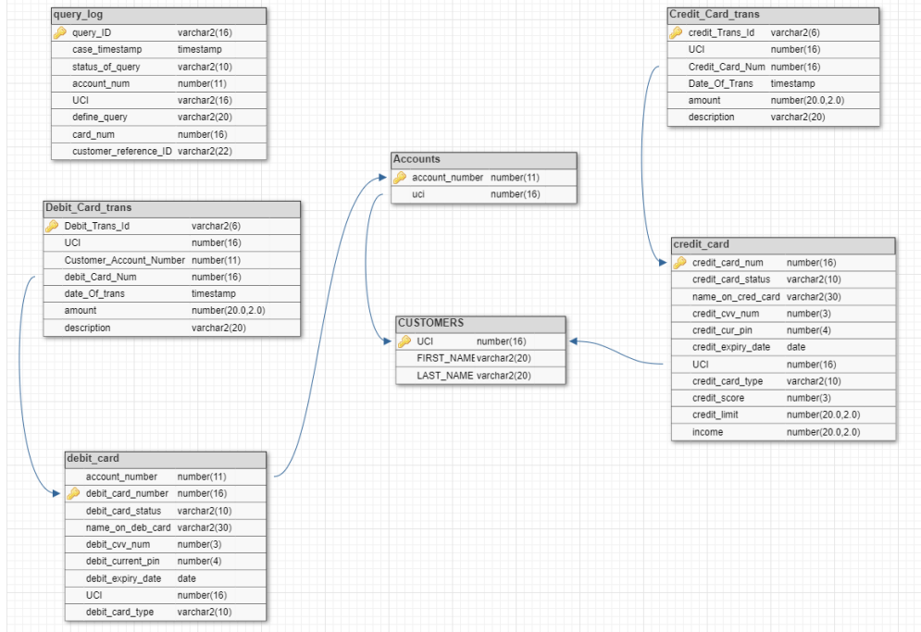
DATABASE

Slide 8
